Slide 1
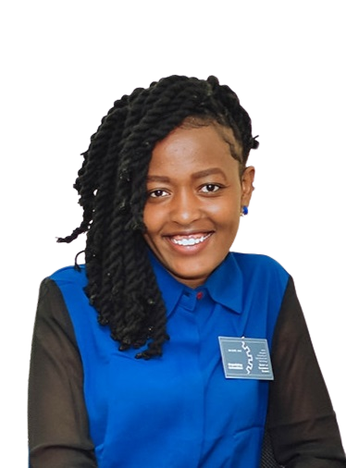
KARIITHI ANNE WANJIKU
BSC.ELECTRONICS AND COMPUTER ENGINEERING

Slide 2

ABSTRACT
Diabetes mellitus is chronic metabolic condition characterized with elevated blood glucose
Diagnosis is based on measurement of blood sugars
Complications include neuropathy and diabetic foot ulcers
Proposed solution is an AI model to screen for diabetic foot and provide continuous sugar level monitoring

Slide 3
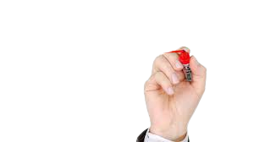
TYPES
There are two types:
Type 1- due to production of little or no insulin occurring before 40 year
Type 2- due to insulin resistance and often occurs past 40 years

Slide 4

CAUSE
Type 1 Diabetes
Genetic predisposition
Autoimmune diseases
Type 2 Diabetes
Metabolic syndrome i.e low HDL, high triglycerides, obesity, high BPs
other lifestyles like smoking

Slide 5

DIAGNOSIS
Diagnosis is based on lab tests and clinical features
Clinical features include glycosuria, polyuria, thirst, polydipsia, hunger, polyphagia, weight loss and fatigue.
Lab tests include blood sugar level testing, HBA1C, C-Peptide among others

Slide 6
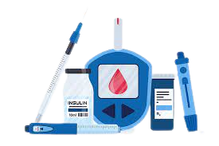
MANAGEMENT
Currently, management of diabetes involves the use of :
Intramuscular insulin in type 1
Oral antidiabetics in type 2

Slide 7
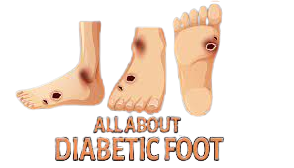
PROBLEM STATEMENT
Diabetic foot is a soft tissue or bone infection below malleoli
It’s the commonest cause of non-traumatic below knee amputation.
Sixty percent of diabetics develop neuropathy and 26.1% of 422 million diabetics develop foot ulcers
Five year mortality rate due to foot ulcers is 50-70% leading to at least 1.5 deaths annually

Slide 8
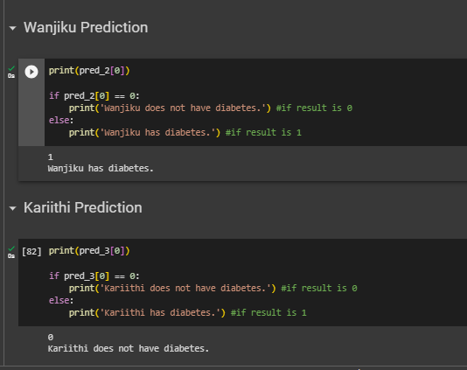

SOLUTION
The proposed system is a 3 in one system:
A) MACHINE LEARNING MODEL
Predict whether one has diabetes or not
2. Screen for diabetic foot by analysing skin color changes

Slide 9
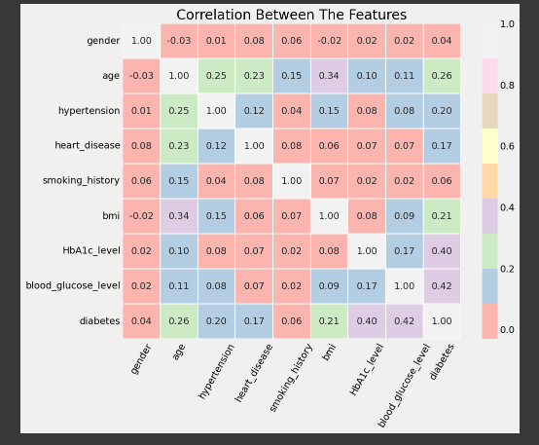
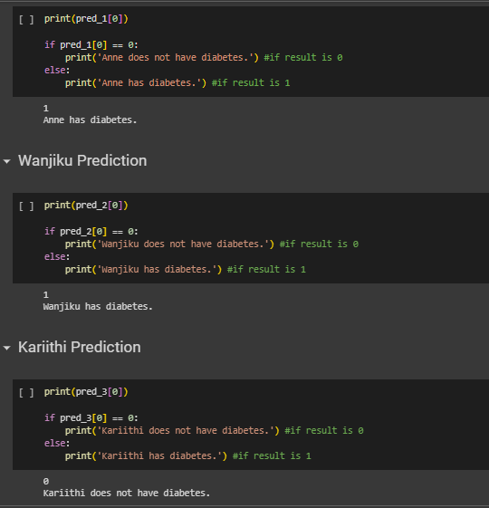
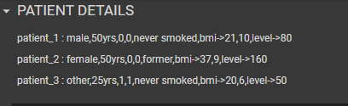
SOLUTION

Slide 10
SOLUTION
The proposed system is a 3 in one system:
B) EMBEDDED SYSTEMS-smart sock
Has temperature sensors that periodically monitor the temperature difference in the foot.
2. Oximeter for measuring SP02, foot temperature

Slide 11
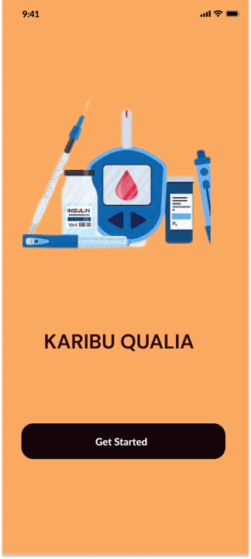
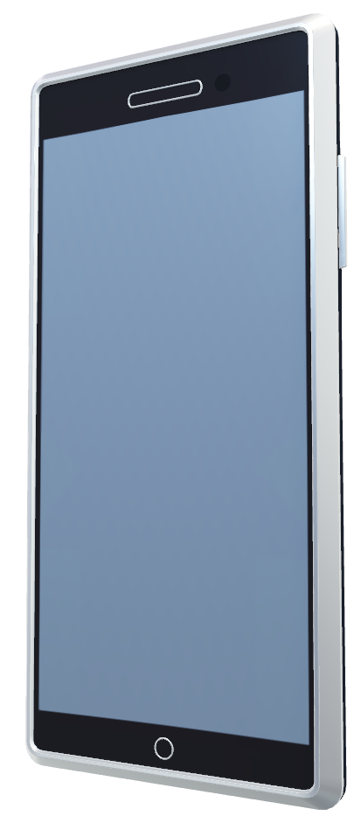
SOLUTION
The proposed system will also have a mobile application which will, based on the classification:
Allow for real time monitoring of patients
Help reduce development of diabetes foot ulcers in patients
Provide recommendation on insulin dosage based on the inference made.

Slide 12

THANKYOU

Slide 13
REFERENCES
https://www.aafp.org/pubs/afp/issues/2013/0801/p177.html
https://www.who.int/health-topics/diabetes#tab=tab_1https://diabetesjournals.org/care/article/46/1/209/148198/Etiology-Epidemiology-and-Disparities-in-the

